Slide 1
Practical Data Science: Recommender Systems
Practical Data Science – COSC2670
Dr. Yongli Ren
(yongli.ren@rmit.edu.au)
Computer Science & IT
School of Science

Slide 2
Outline
Highlight
Q/A

Slide 3
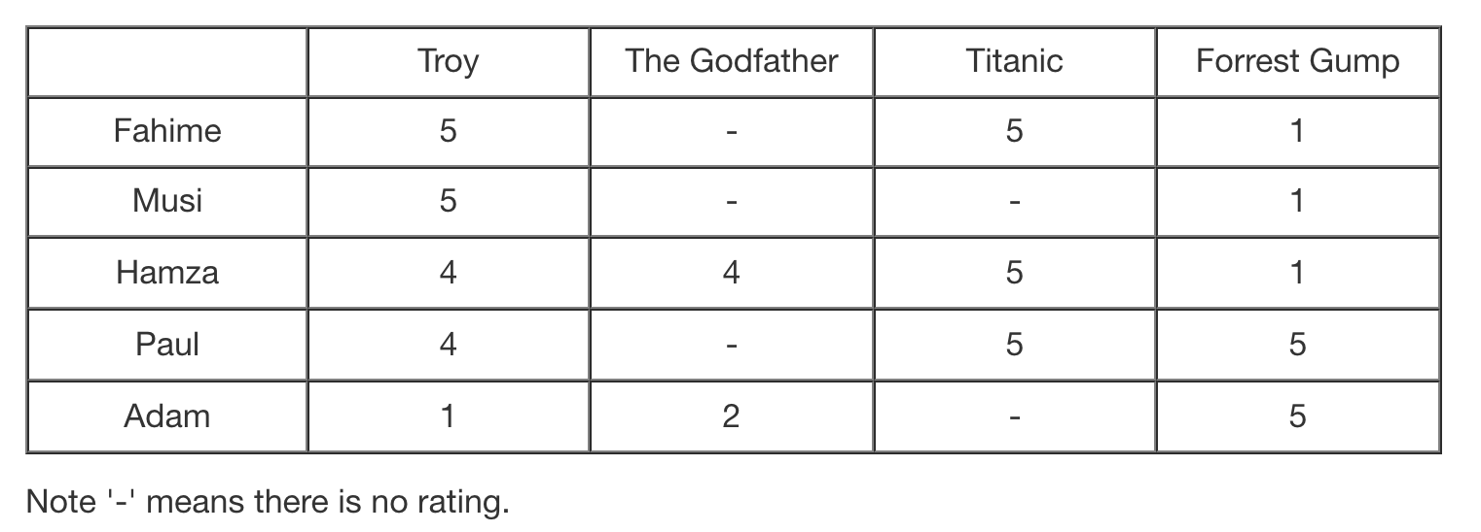
What is Collaborative Filtering?
Collaborative filtering (CF)
is a technique used by recommender systems
the most successful recommendation technique to date
is the idea of recommending an item depending on other like minded individuals
consists of
set of users,
set of items, and
set of opinions about the item: ratings, reviews or purchases.
User-Item Rating Matrix

Slide 4
What is Collaborative Filtering?
In the narrower sense,
collaborative filtering is a method of making automatic predictions (filtering) about the interests of a user
by collecting preferences or taste information from many users (collaborating).
The underlying assumption is that
if person A has the same opinion as person B on an issue,
A is more likely to also have B's opinion on a different issue than that of a randomly chosen person.
This differs from MovieAvg (or TopPop)
The simpler approach of giving an average score (or popularity) for each item of interest.
https://en.wikipedia.org/wiki/Collaborative_filtering

Slide 5
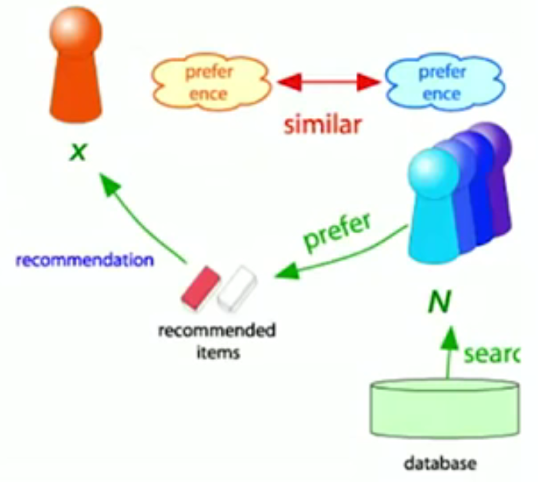
Collaborative Filtering - Neighbourhood-based Methods
Consider the active user x;
find set N of other users whose ratings are "similar" to x's ratings;
Estimate x’s ratings based on ratings of users in N
https://www.youtube.com/watch?v=h9gpufJFF-0

Slide 6
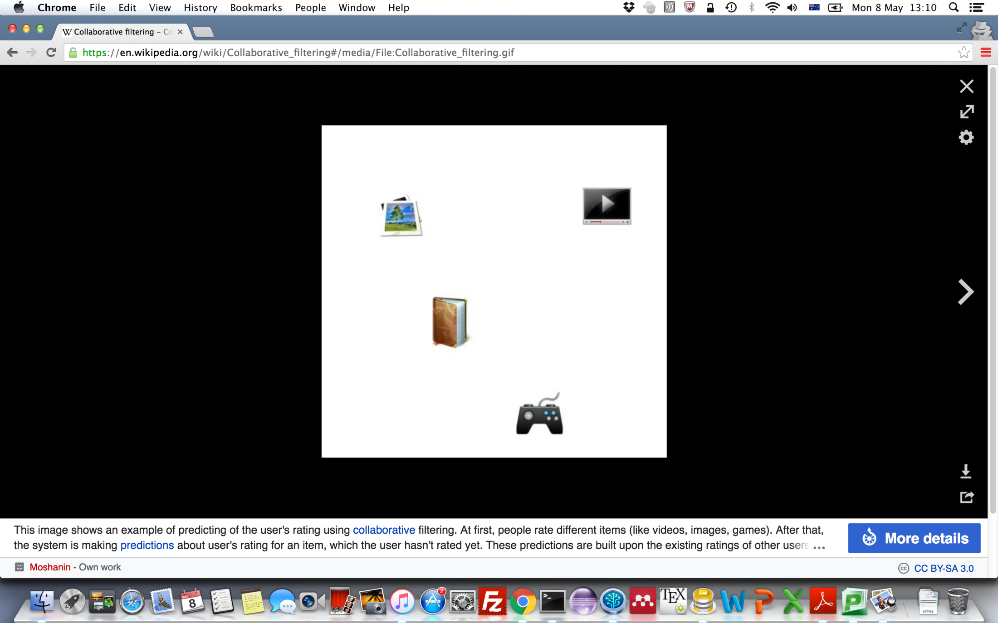
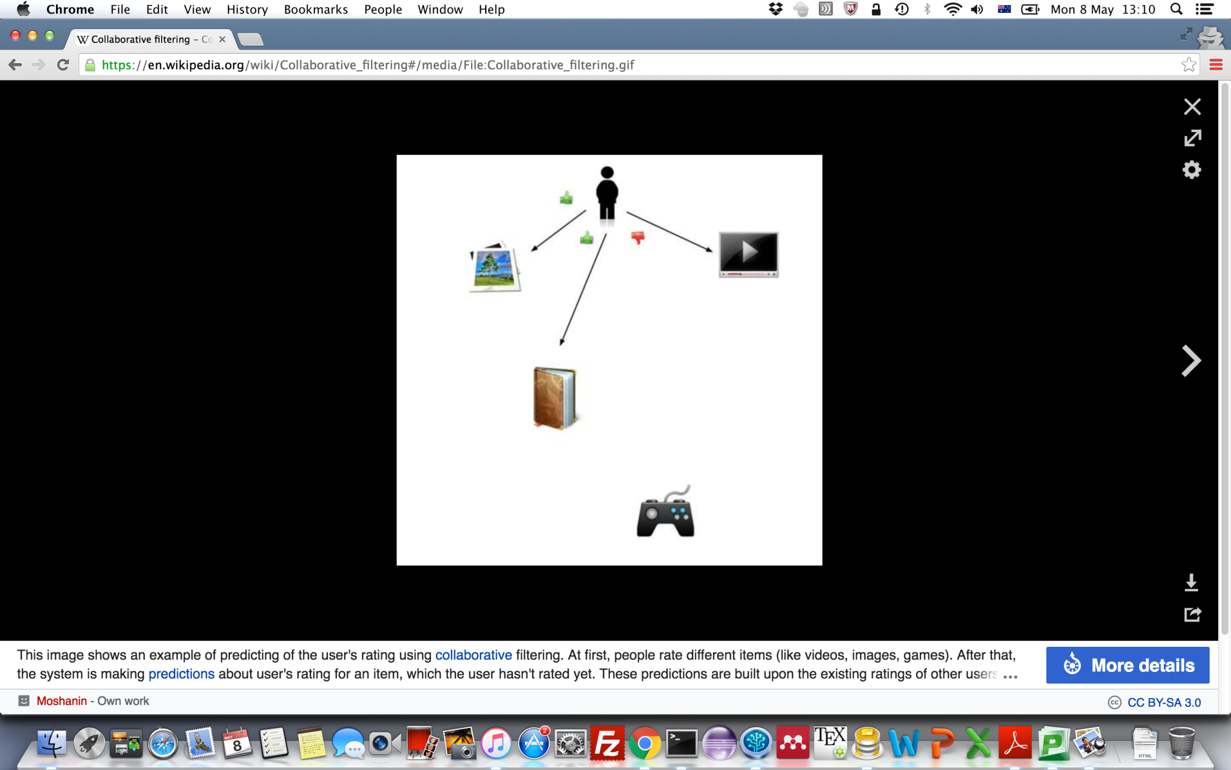
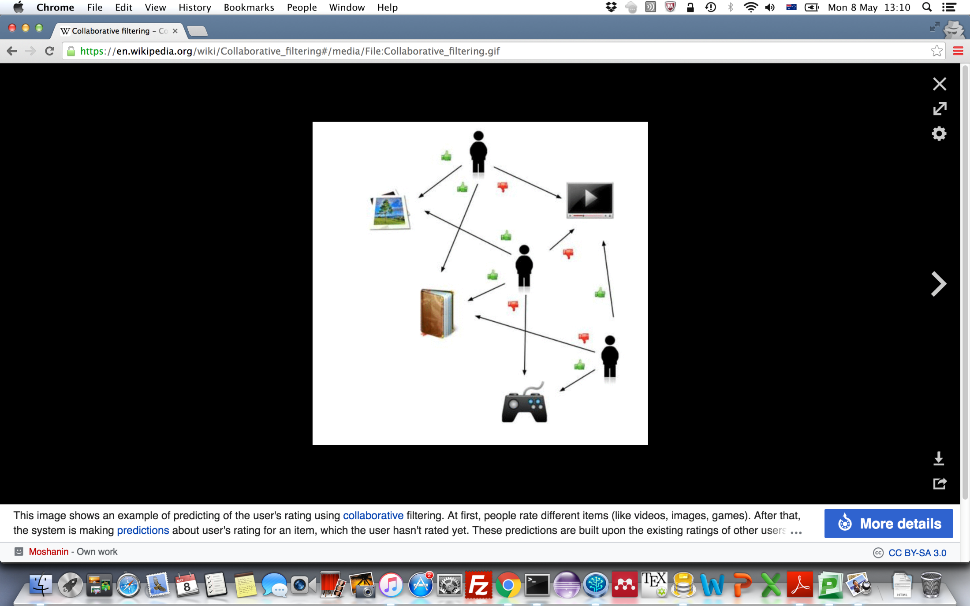
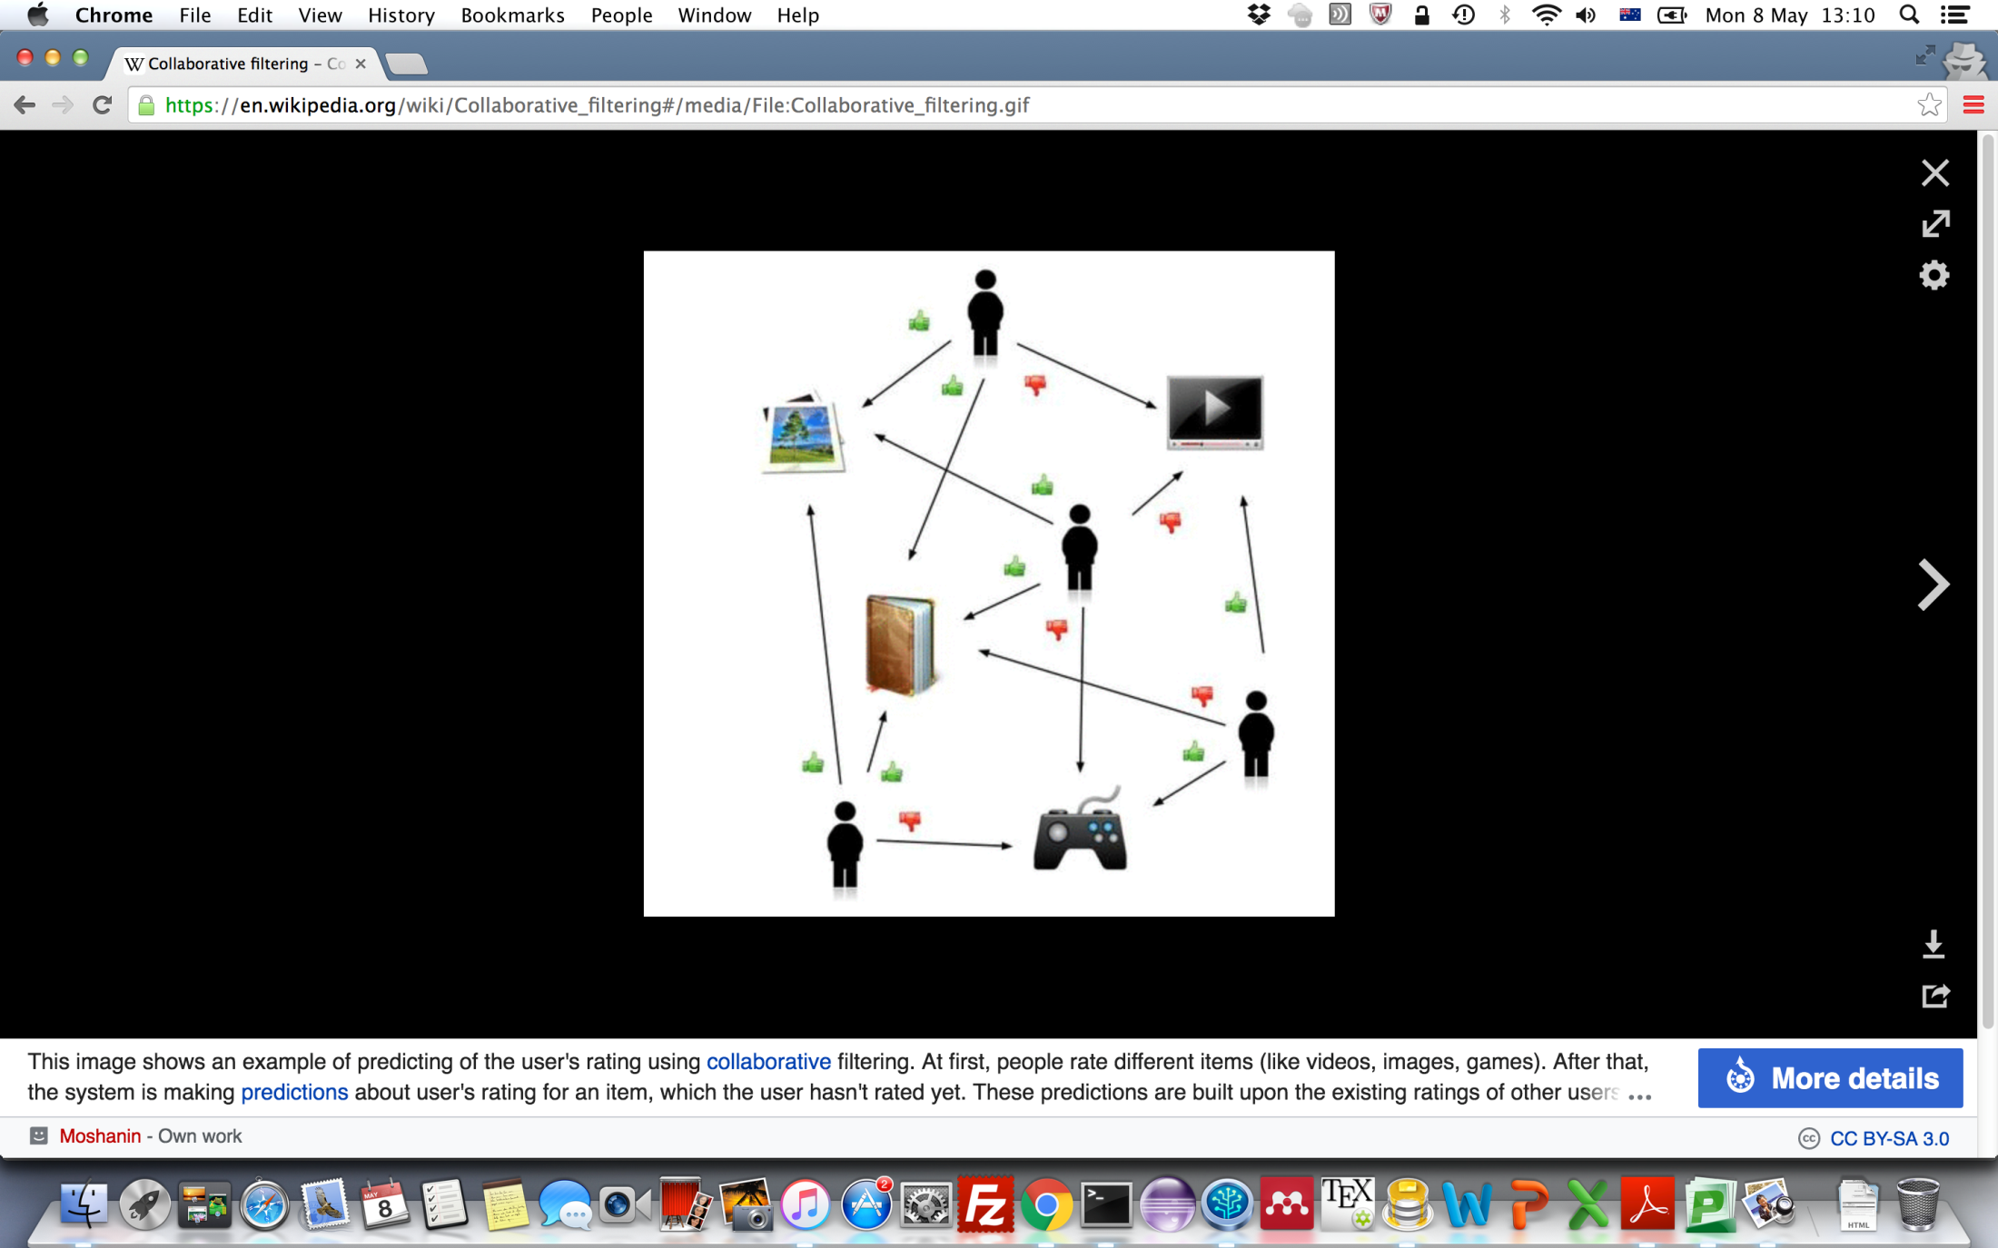
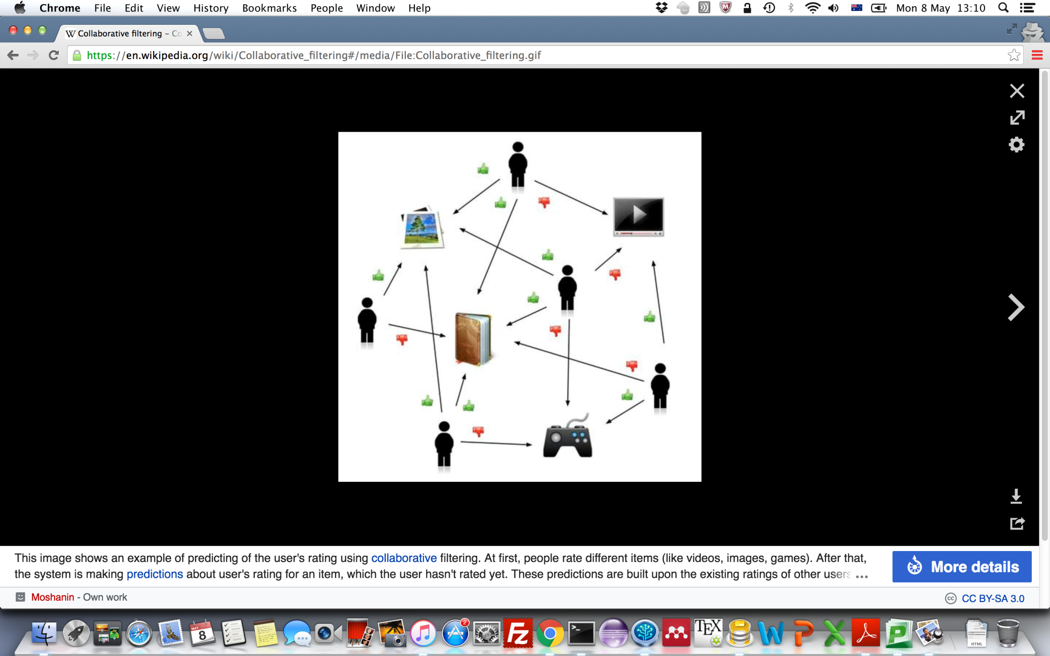
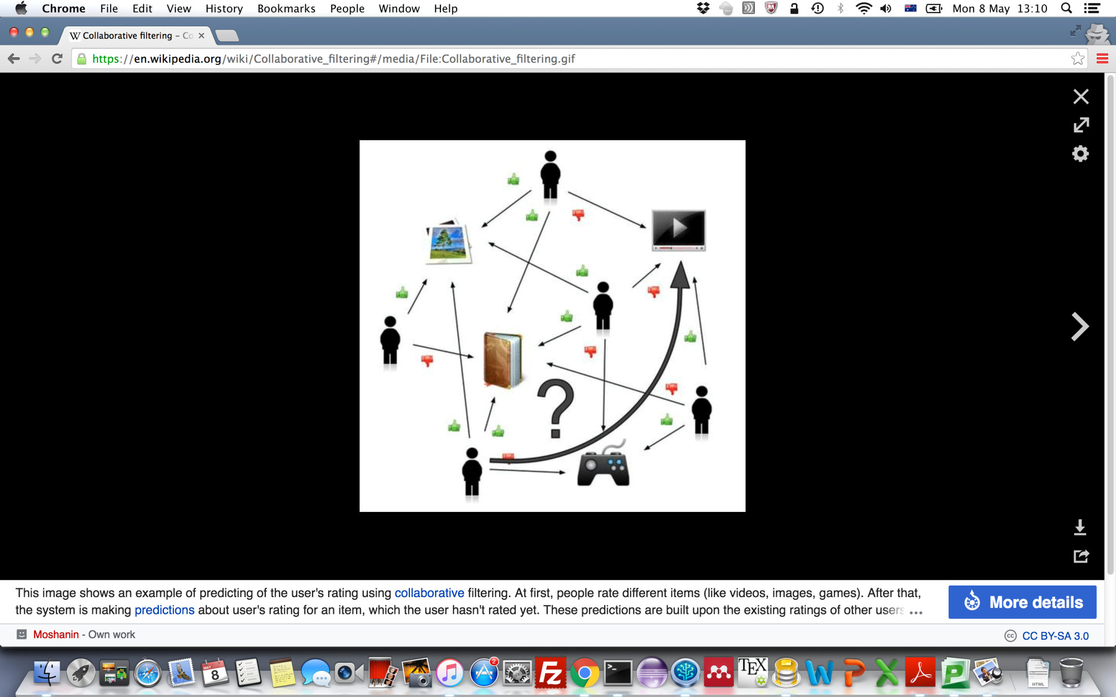
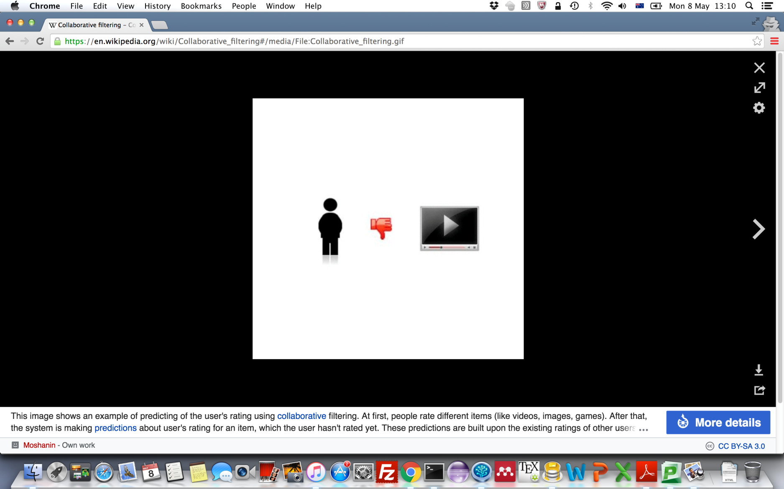
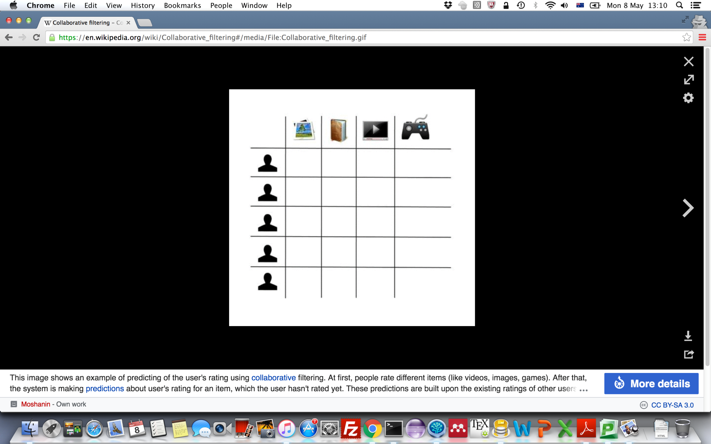
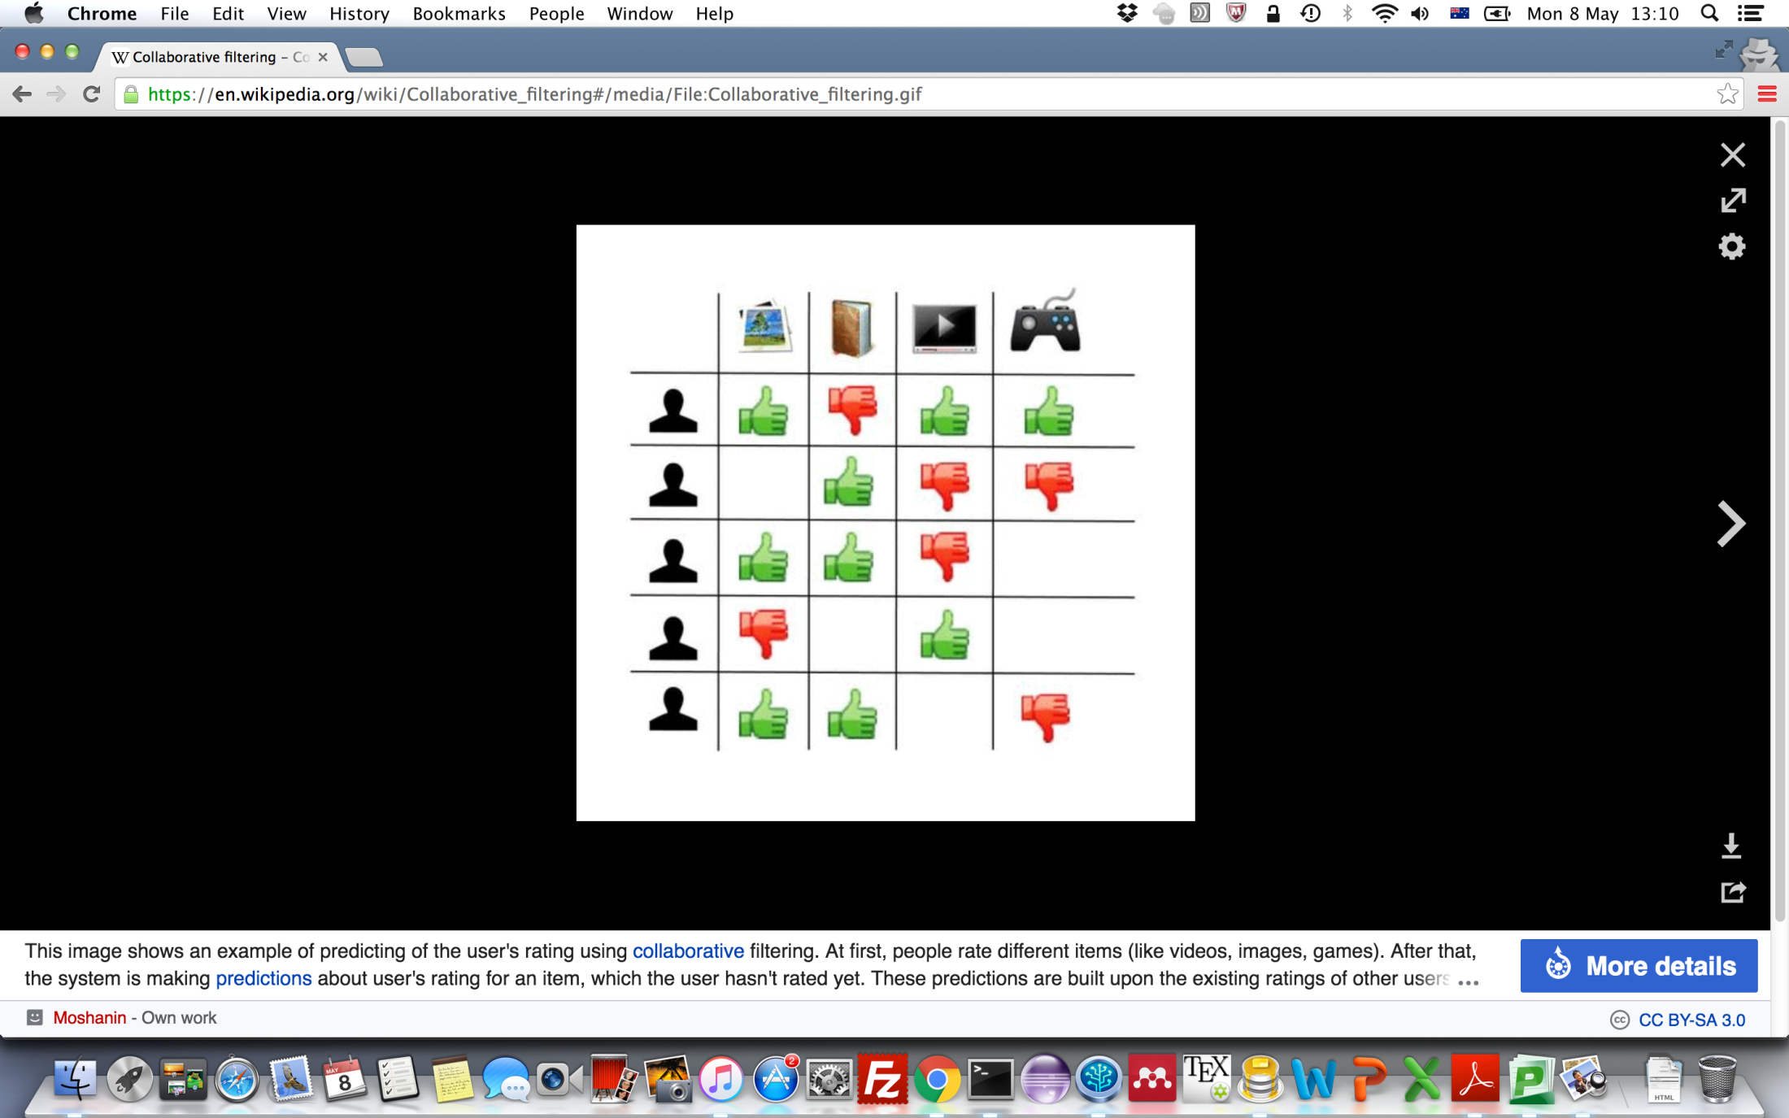
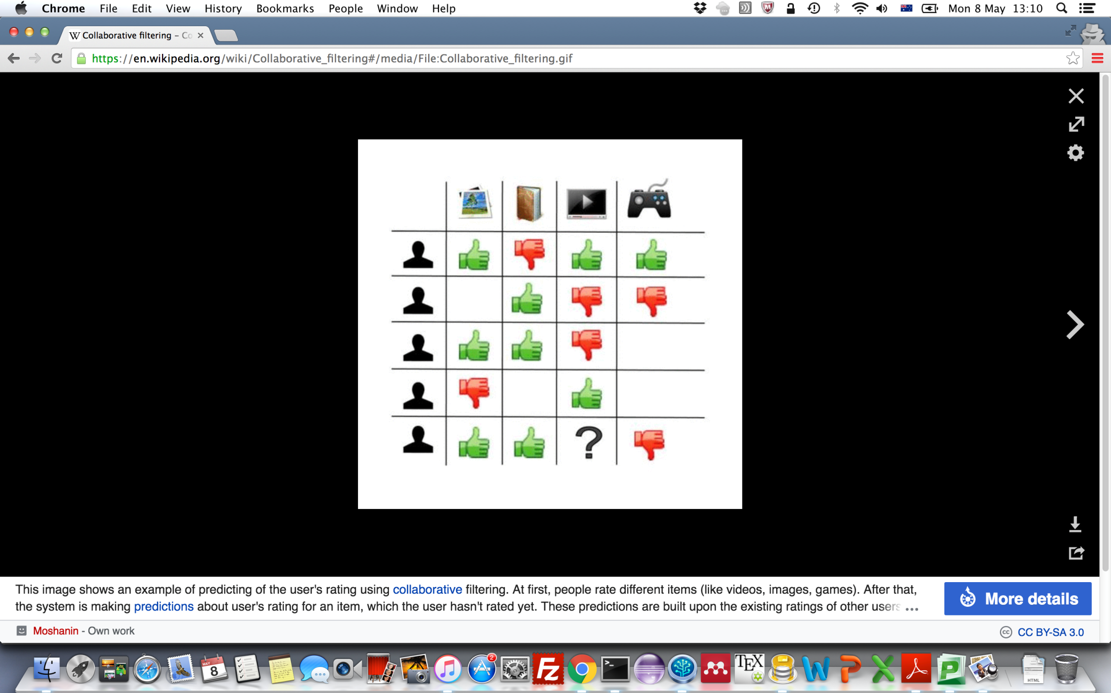
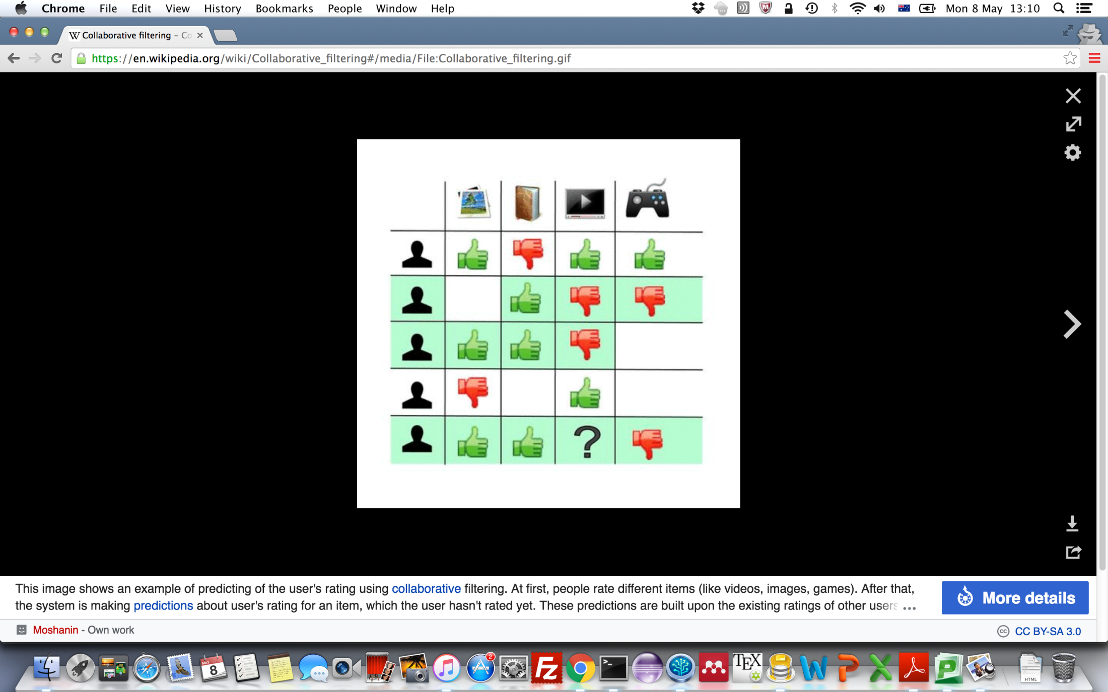

The Process of Collaborative Filtering
This image shows an example of predicting of the user's rating using collaborative filtering.
People rate different items.
The system is making predictions about the user's rating for an item, which the user hasn't rated yet.
These predictions are built upon the existing ratings of other users, who have similar ratings with the active user.
For instance, in our case the system has made a prediction, that the active user won't like the video.
https://en.wikipedia.org/wiki/Collaborative_filtering

Slide 7
kNN-based Collaborative Filtering
Input: the User-Item rating matrix.
Output: the rating of the active user on the target item
For the active user
u1
Similarities to other users
u2
u3
u4
Find the k-nearest neighbours
u5
Aggregate neighbours’ ratings
u1
u2
u3
u4
u5
1 | 2 | 2 | 0
Predict rating on target item
The number of items they have common opinions
https://en.wikipedia.org/wiki/Collaborative_filtering

Slide 8
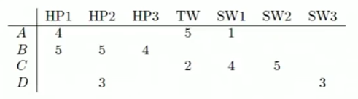
Similar Users
Consider users A and B with rating vectors (row A and B)
We need a similarity metric sim (A,B):
Capture intuition that sim(A,B) > sim(A,C)
https://www.youtube.com/watch?v=h9gpufJFF-0

Slide 9
How about Missing Values? - treating as 0s?
i
1
2
3
4
5
6
7
Euclidean distance
d(A,B) = math.sqrt(1 + 25 + 16 + 25 + 1)
= 8.25
d(A,C) = math.sqrt(16 + 9 + 9 + 25)
= 7.68

Slide 10
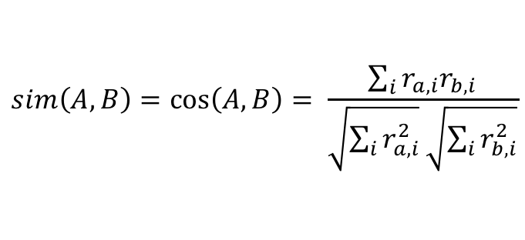
How about Missing Values? - treating as 0s?
i
1
2
3
4
5
6
7
$$sim\left(A,B\right)=\cos\left(A,B\right)= \frac{\sum_{i}{r_{a,i}r_{b,i}}}{\sqrt{\sum_{i}{r_{a,i}^{2}}}\sqrt{\sum_{i}{r_{b,i}^{2}}}}$$
Cosine similarity
Cos(A, B) = (4 * 5)/(math.sqrt(16 + 25 + 1)*math.sqrt(25 + 25 + 16)) = 0.38
Cos(A, C) = (5 * 2 + 1*4)/(math.sqrt(16 + 25 + 1) * math.sqrt(4 + 16 + 25))
= 0.32
sim(A,B) > sim(A,C), but not by much

Slide 11
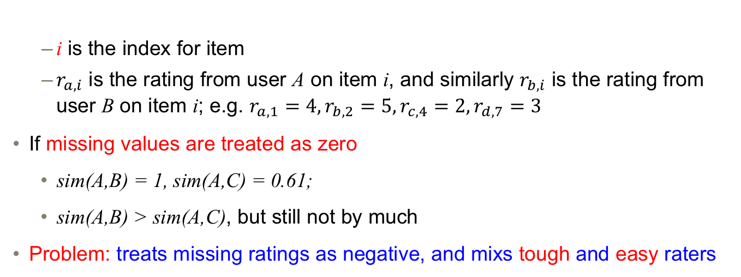
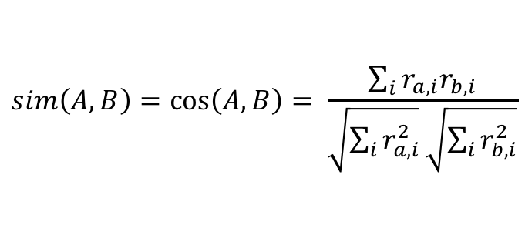

Similar Users - treating as 0s? + Co-rated Item Set
i
1
2
3
4
5
6
7
Co-rated item set
$$sim\left(A,B\right)=\cos\left(A,B\right)= \frac{\sum_{i}{r_{a,i}r_{b,i}}}{\sqrt{\sum_{i}{r_{a,i}^{2}}}\sqrt{\sum_{i}{r_{b,i}^{2}}}}$$
$$=\frac{\sum_{i∈I(A)∩I(B)}{r_{a,i}r_{b,i}}}{\sqrt{\sum_{i∈I(A)∩I(B)}{r_{a,i}^{2}}}\sqrt{\sum_{i∈I(A)∩I(B)}{r_{b,i}^{2}}}}$$
i is the index for item
$r_{a,i}$ is the rating from user A on item i, and similarly $r_{b,i}$ is the rating from user B on item i; e.g. $r_{a,1}=4,r_{b,2}=5,r_{c,4}=2,r_{d,7}=3$
If missing values are treated as zero
sim(A,B) = 1, sim(A,C) = 0.61;
sim(A,B) > sim(A,C), but still not by much
Problem: treats missing ratings as negative, and mixs tough and easy raters
e.g. sim(A, C) = (5*2 + 1* 4)/(sqrt(25 + 1) sqrt(4 + 16)) = 0.6139406, which is around 0.61
https://www.youtube.com/watch?v=h9gpufJFF-0

Slide 12
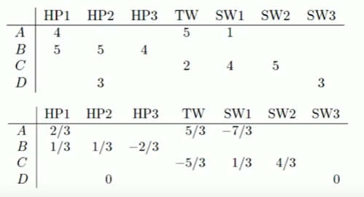
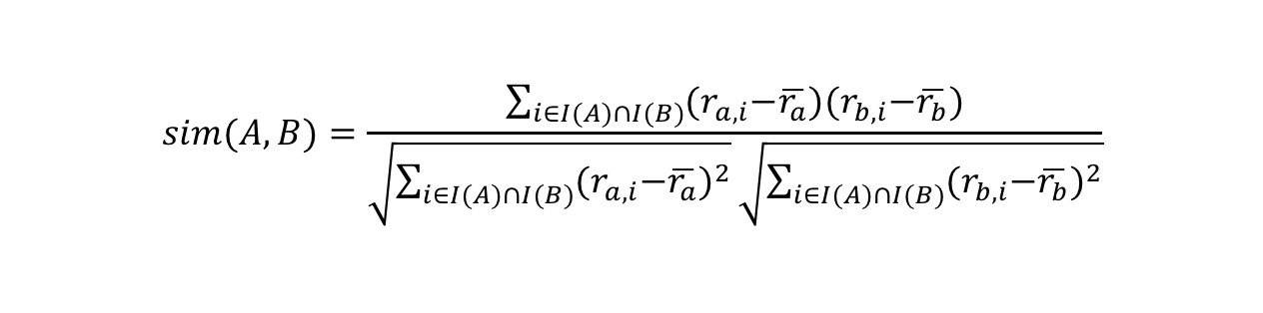
Similar Users -Centered Cosine Similarity
Normalize ratings by subtracting row mean
(4+5+1)/3
(5+5+4)/3
(2+4+5)/3
(3+3)/2
$$sim(A,B)=\frac{\sum_{i∈I(A)∩I(B)}{{(r}_{a,i}−\overline{r_{a}}){(r}_{b,i}−\overline{r_{b}})}}{\sqrt{\sum_{i∈I(A)∩I(B)}{{{(r}_{a,i}−\overline{r_{a}})}^{2}}}\sqrt{\sum_{i∈I(A)∩I(B)}{{{(r}_{b,i}−\overline{r_{b}})}^{2}}}}$$
https://www.youtube.com/watch?v=h9gpufJFF-0

Slide 13
Similar Users -Centered Cosine Similarity
sim(A,B) = cos(A, B) = 1
sim(A, C) = -0.73
sim(A,B) > sim(A,C)
Captures intuition better
Missing ratings treated as "average”
Handles "tough raters" and "easy raters“
Also known as “Pearson Correlation Coefficient (PCC)”
https://www.youtube.com/watch?v=h9gpufJFF-0

Slide 14
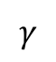
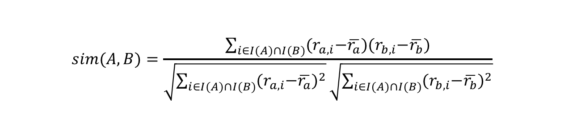
Similar Users -Co-rated Item Set in Centered Cosine Similarity
sim(A,B) = cos(A, B) = 1
sim(A, C) = -0.73
sim(A,B) > sim(A,C)
If the size of co-rated item set is too small, the corresponding similarity is not reliable. Thus, significance weighting is introduced:
where is a pre-defined a parameter.
$$sim(A,B)=\frac{\sum_{i∈I(A)∩I(B)}{{(r}_{a,i}−\overline{r_{a}}){(r}_{b,i}−\overline{r_{b}})}}{\sqrt{\sum_{i∈I(A)∩I(B)}{{{(r}_{a,i}−\overline{r_{a}})}^{2}}}\sqrt{\sum_{i∈I(A)∩I(B)}{{{(r}_{b,i}−\overline{r_{b}})}^{2}}}}$$
$$sim\left(A,B\right)← \frac{\min\left(\left|I\left(A\right)∩I\left(B\right)\right|, γ\right)}{γ}sim(A,B)$$
$$γ$$
https://www.youtube.com/watch?v=h9gpufJFF-0

Slide 15
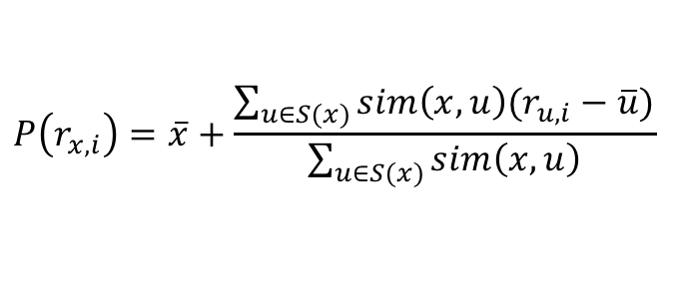
Rating Predictions
Let r_{x} be the vector of user x's ratings
let S(x) be the set of k users most similar to x who have also rated item i
S(x) = {u2, u3}
Prediction for users x and item i
option 1: average rating in the neighbourhood;
( + ) / 2 =
option 2: weighted average rating in the neighbourhood
(2 * + 2 * ) / (2+2) =
Option 3: weight the difference to the average rating by the corresponding similar users:
i
u1
u2
u3
u4
x
u1
u2
u3
u4
x
1 | 2 | 2 | 0
$$P\left(r_{x,i}\right)=\overline{x}+\frac{\sum_{u∈S(x)}{sim\left(x,u\right)(r_{u,i}−\overline{u})}}{\sum_{u∈S(x)}{sim\left(x,u\right)}}$$
https://www.youtube.com/watch?v=h9gpufJFF-0

Slide 16

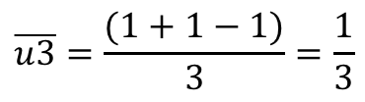
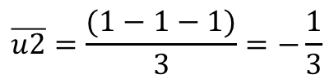
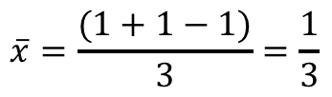
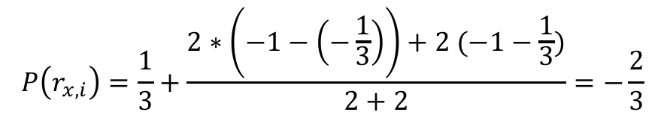
Rating Predictions
Let r_{x} be the vector of user x's ratings
let S(x) be the set of k users most similar to x who have also rated item i
S(x) = {u2, u3}
Prediction for users x and item i
Option 3: weight the the difference to the average rating by the corresponding similar users:
: 1; : -1
Then,
i
u1
u2
u3
u4
x
$$\overline{x}=\frac{(1+1−1)}{3}=\frac{1}{3}$$
u1
u2
u3
u4
$$\overline{u2}=\frac{(1−1−1)}{3}=−\frac{1}{3}$$
x
1 | 2 | 2 | 0
$$\overline{u3}=\frac{(1+1−1)}{3}=\frac{1}{3}$$
$$P\left(r_{x,i}\right)=\frac{1}{3}+\frac{2∗\left(−1−\left(−\frac{1}{3}\right)\right)+2 (−1−\frac{1}{3})}{2+2}=−\frac{2}{3}$$
https://www.youtube.com/watch?v=h9gpufJFF-0

Slide 17
Item-item Collaborative Filtering
So far: user-user collaborative filtering
Another view: item-item
for item i, find other similar items
estimate rating for item i based on ratings for similar items;
can use same similarity metrics and prediction functions as in user-user model
https://www.youtube.com/watch?v=h9gpufJFF-0

Slide 18
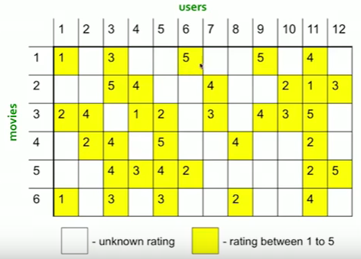
Item-item Collaborative Filtering (|N| = 2)
https://www.youtube.com/watch?v=h9gpufJFF-0

Slide 19
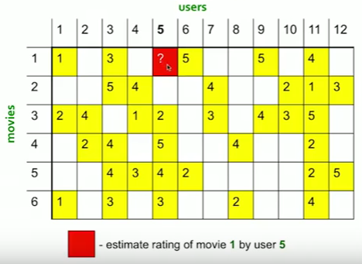
Item-item Collaborative Filtering (|N| = 2)
https://www.youtube.com/watch?v=h9gpufJFF-0

Slide 20
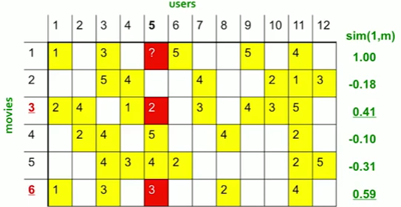
Item-item Collaborative Filtering (|N| = 2)
Neighbour selection: Identify movies similar to movie 1, rated by user 5
Here, we use Centered Cosine as similarity:
Subtract mean rating from each movie: meanRating1 = (1+3+5+5+4)/5 = 3.6 row 1 = [-2.6, 0, -0.6, 0, 0, 1.4, 0, 0, 1.4, 0, 0.4)
Compute cosine similarities between rows
Predict by taking weighted average (Option 2):
(0.41 * 2 + 0.59 * 3)/(0.41 + 0.59) = 2.6
https://www.youtube.com/watch?v=h9gpufJFF-0

Slide 21
Item-item Collaborative Filtering (|N| = 2)
Neighbour selection: Identify movies similar to movie 1, rated by user 5
Here, we use Centered Cosine as similarity:
Subtract mean rating from each movie: meanRating1 = (1+3+5+5+4)/5 = 3.6 row 1 = [-2.6, 0, -0.6, 0, 0, 1.4, 0, 0, 1.4, 0, 0.4)
Compute cosine similarities between rows
Predict by taking the weighted difference to the average rating by the corresponding similar users(Option 3):
3.6 + (0.41 * (2 – 3) + 0.59*(3-2.6))/(0.41 + 0.59) = 3.426
https://www.youtube.com/watch?v=h9gpufJFF-0

Slide 22
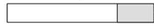
Evaluation - Validate Strategy
Training Test Split.
Randomly dividing your data into a training set with X% of the observations and keeping the rest as a holdout data set
(a data set that’s never used for model creation)
This is the most common technique.
Test examples
Training examples
D. Cielen et. Al., Chapter 3
http://www.imtech.res.in/raghava/gpsr/Evaluation_Bioinformatics_Methods.htm

Slide 23
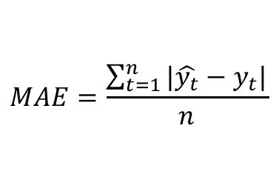
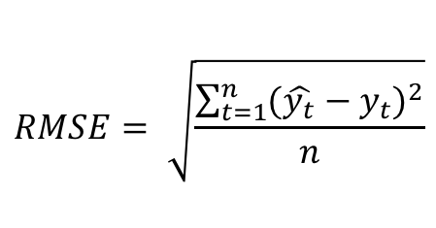
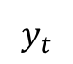
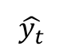
Evaluation - MAE and RMSE
Mean-Absolute-Error (MAE) and Root-mean-square error (RMSE) measure the differences between the predicted ratings by a recommender system and the actual ratings observed.
https://en.wikipedia.org/wiki/Mean_absolute_error
https://en.wikipedia.org/wiki/Root-mean-square_deviation
where T is the test set, and n is the size of the test set; is the predicted rating for the actual observed rating
$$MAE=\frac{\sum_{t=1}^{n}{|\hat{y_{t}}−y_{t}|}}{n}$$
$$RMSE= \sqrt{\frac{\sum_{t=1}^{n}{{(\hat{y_{t}}−y_{t})}^{2}}}{n}}$$
$$\hat{y_{t}}$$
$$y_{t}$$

Slide 24

Thanks!

